Slide 1
Why is my room so cold?
Helping people make better decisions through mathematical analysis

Slide 2
What issues are people facing?
Fuel Prices
Making winter heating infeasible
Poor Housing Stock
“Leaky” insulation increases heat demand
Increasing cost of living
Inflation increasing the financial burden.

Slide 3
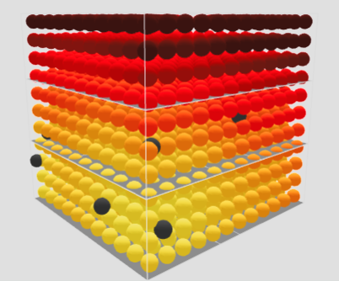
How does Modelling Help?
Day-to-Day Decisions
Encouraging occupant activity that maximises the health of the home
Improvement and Repair
Informing intelligent investment
Risk Assessment
Finding homes that are most at risk from damp and mould

Slide 4


How do we create an accurate model?
$$T_{t}=kT_{xx}+h(x,t)$$
$$T\left(x,0\right)=f(x)$$
Heat Sources/Drains
Transfer Coefficients
Starting Point

Slide 5


Do we need an accurate starting point?
$$T\left(x,0\right)≠\hat{T}(x,0)$$
$$\lim_{t→∞}\left|T\left(x,t\right)−\hat{T}(x,t)\right|=0$$

Slide 6
Bridging the gap
Translating theoretical results into the real world
Higher Dimensions
Continuous vs Discrete
Going from one dimension to three
Data sampling in real time

Slide 7
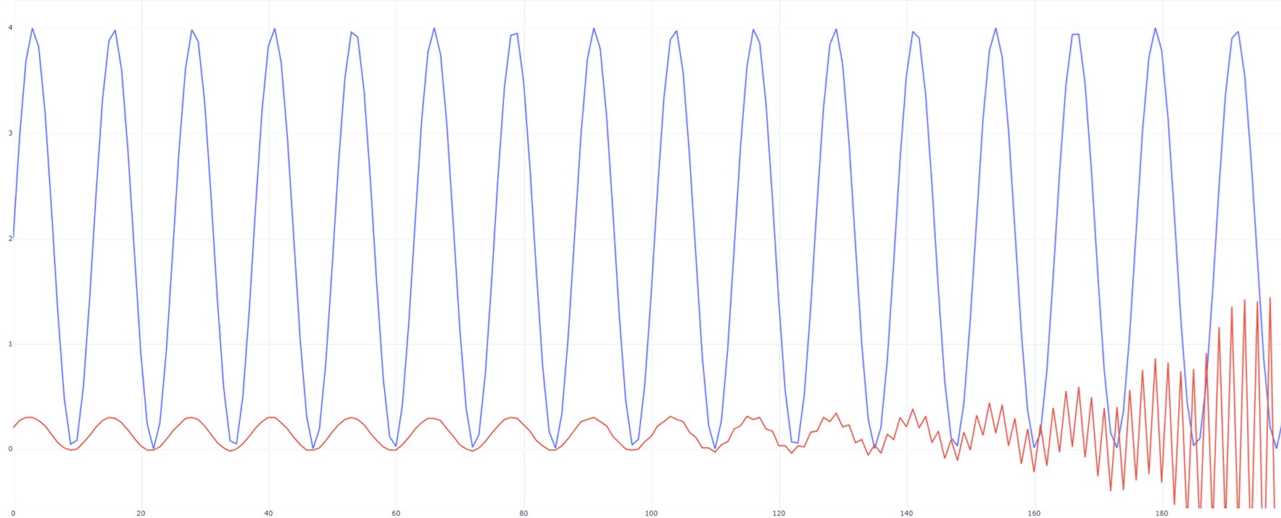
Bridging the gap
Translating theoretical results into the real world

Slide 8
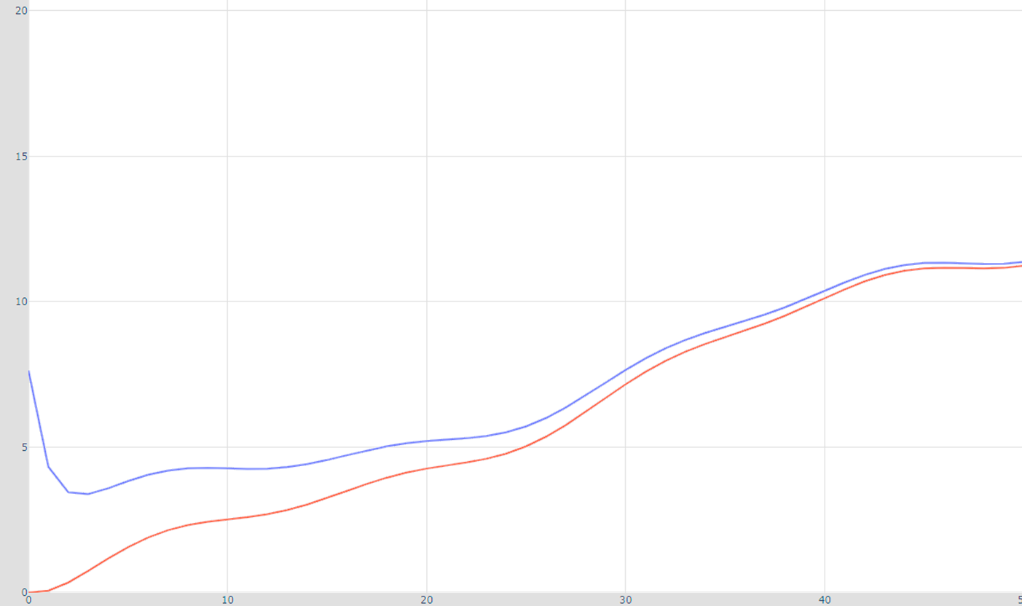
Bridging the gap
Translating theoretical results into the real world

Slide 9
What has Changed?
Confidence
Intuition
About conclusions drawn from empirical observation.
Guiding further research and exploration

Slide 10
Where do we go now?

